Slide 1
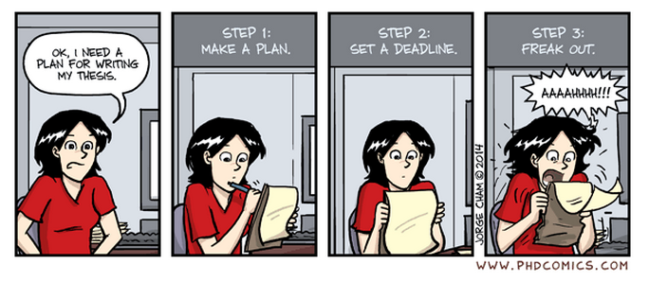


Birmingham International Academy
Thesis Writing for Scientists and Engineers
Session 1
Tutor’s name: Jane Sjoberg
Please sit near the front and near others

Slide 2

Please enrol on the Canvas course
https://canvas.bham.ac.uk/enroll/PRCKWB
Materials and hand-outs (with keys) will be posted in Modules
Please contribute questions and observations on the ‘Discussion’ boards

Slide 3
Monday 1 June 3-5 pm
Tuesday 2 June 3-5 pm
Wednesday 3 June 3-5pm
Thursday 4 June 3-5pm
Friday 5 June 3-5 pm
We will focus on the organisation of a thesis and also look at the language e.g. reporting verbs, passive forms, the language of comparison
Today:
Strategies for good writing
Organisation of theses
Steps in the Introduction section
Academic Writing Style

Slide 4
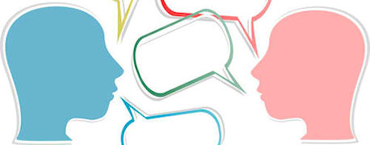
a) If you do not do so already, learn to think in English.
b) Write something - even if only a couple of sentences - every day.
c) Make certain that you reproduce as exactly as possible the ideas of your teachers. In this way you can be certain that what you write is correct.
d) Copy out and join together sections from books, the Web etc and present them as your own work. This is an even better way of making sure that you are correct and that you do not make mistakes.
e) Read for at least two hours a day in your subject area to improve your familiarity with previous work, and the way it is discussed.
f) Learn lists of specialised words in your subject area, and of typical academic linking expressions such as ‘however’, ‘moreover’ etc. This will make what you write sound important and impressive.
g) Learn to plan your writing by using diagrams (tables, mind maps etc.) as a way of stimulating ideas, and of deciding on the organisation of the writing.
Good advice or Bad advice?

Slide 5
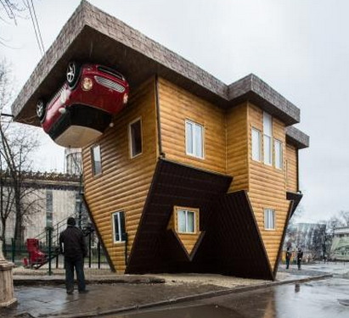
STRUCTURE

Slide 6
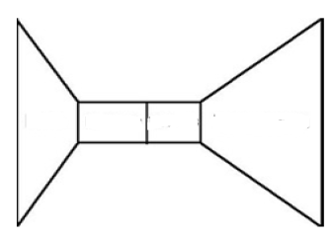
How does this image represent a thesis?

Slide 7
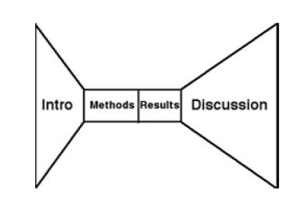

Slide 8
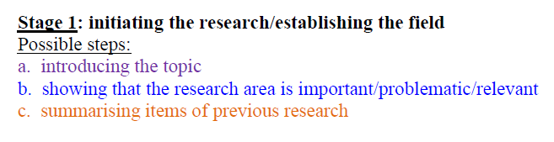
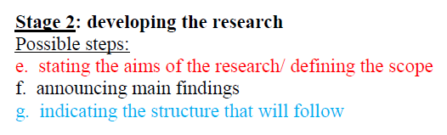
STRUCTURING THE INTRODUCTION

Slide 9
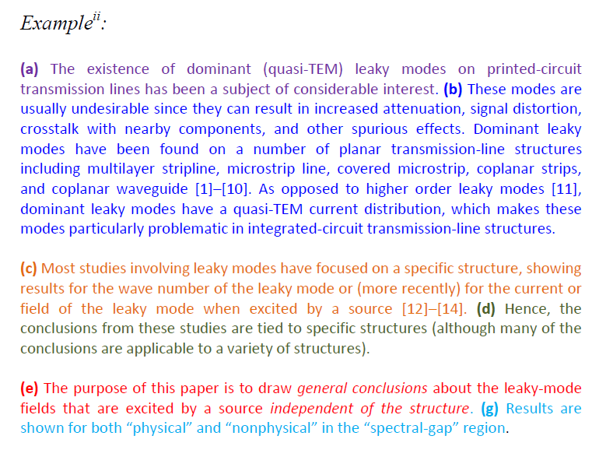

Slide 10
Establishing the field
THE existence of dominant (quasi-TEM) leaky modes on printed-circuit transmission lines has been a subject of considerable interest. These modes are usually undesirable since they can result in increased attenuation, signal distortion, crosstalk with nearby components, and other spurious effects.
Dominant leaky modes have been found on a number of planar transmission-line structures including multilayer stripline, microstrip line, covered microstrip, coplanar strips, and coplanar waveguide [1]–[10]. As opposed to higher order leaky modes [11], dominant leaky modes have a quasi-TEM current distribution, which makes these modes particularly problematic in integrated-circuit transmission-line structures.
Summarising Previous Research
Preparing for Present Research (by indicating a gap in previous research)
Most studies involving leaky modes have focused on a specific structure, showing results for the wavenumber of the leaky mode or (more recently) for the current or field of the leaky mode when excited by a source [12]–[14]. Hence, the conclusions from these studies are tied to specific structures (although many of the conclusions are applicable to a variety of structures).
The purpose of this paper is to draw general conclusions about the leaky-mode fields that are excited by a source independent of the structure. Results are shown for both “physical” and “nonphysical” in the “spectral-gap” region.
Introducing Present Research (by stating the aim)

Slide 11

Task 1
Try and identify any steps in the following two journal article introductions.
Not all the possible steps are present, and sometimes 2 are taken at the same time.

Slide 12
One possible interpretation of what the author is doing:
1. Design considerations for inspiratory muscle training systems
Recent studies of respiratory muscle training have lent support to its ergogenic influence upon time trial performance [1], as well as on the time to the limit of tolerance during moderate intensity exercise [2-4]. In contrast, studies that have utilized either incremental tests to the limit of tolerance [5, 6] or very strenuous fixed-intensity tests [7-9] have failed to observe any statistically significant effect upon performance. It is clear that both respiratory and inspiratory muscle training can improve exercise performance under certain conditions. However, it is possible that exercise performance could be improved further if a superior training technology were available. There are a wide range of commercially available devices, all of which are suboptimal in their functionality. The present paper describes the limitations of existing technologies and explores novel means of overcoming these shortcomings. Potential design solutions are defined and compared.

Slide 13
One possible interpretation of what the author is doing:
2. Towards deflection prediction and compensation in machining of low-rigidity parts
Achieving the right profile in machining low-rigidity (‘flexible’) parts increasingly depends on the use of computer aided design/manufacture (CAD/CAM) packages for defining optimal cutting strategies and tool paths. The NC part programming for complex surfaces has been well supported by significant developments in tool path modelling and verification techniques. However, most of the existing techniques and models are based on idealized geometry and do not take into account factors such as variable cutting forces, part/tool deflection and static and dynamic compliance during machining [1], leading to additional machining errors that are difficult to predict and control. The current industrial practices employed to compensate for such errors are based on extensive experimentation using trial-and-error approaches leading to increased cost and lead times.
Recently a number of research efforts have been reported that take into account the tool/part deflection during machining. Kline and DeVor [2] linked a cutting model with deflection models of the tool and the part and used the results to predict and control surface finish by modifying cutting parameters. Lim and Menq [3] proposed a model for prediction of surface errors using a ball end mill cutter that took into account different cutting strategies. Feng and Menq [4] have improved the above model by taking into account the instantaneous and regenerative feedback of the cutting system deflection to establish the chip geometry in the cutting force algorithm. The deflection and cutting models were also enriched by considering additional sources of error such as machine set-up error, spindle and axis tilt, vibration and cutter centre offset run-out [5]. Work has also been reported using artificial neural networks (ANNs) for force and form error prediction [6] that have claimed results superior to those of similar analytical models with the added advantage of relatively easy implementation and low cost system maintenance [7]. A number of specialist finite element analysis (FEA) software packages are being used to simulate manufacturing processes such as metal cutting. These packages use mathematical theories and non-linear numerical algorithms to model plastic flow, heat conduction, thermomechanical coupling, dynamic behaviour and contact mechanics with friction [8, 9]. Several different methods are also being used for cutting simulation and numerically controlled (NC) verification based on Z-map, dexel, discrete vector and voxel based representations [10].
Despite the significant developments in NC simulation and verification there is still a knowledge gap in identifying the impact of deflection on the process of metal removal and there is a lack of systematic approaches to modelling and prediction of the component errors due to deflection in thin-walled structures.
This paper reports on a new integrated methodology and initial validation results for predicting and compensating surface errors due to deflection in machining of low-rigidity components.

Slide 14


Slide 15
Task 2
What were the questions answered by the other sentences in this introduction (below)?
Match the questions A-H with the sentences.
The questions are suggestions – others may be possible.

Slide 16
A. What materials were tested for that component?/ What did the tests consist of?
B. What materials have been used?/ How do they work?
C. What components do such systems have?/ What are the existing systems like?
D. Which seems to be most suitable for developing countries?/ What type has been most popular?
E. What field trials were carried out?/ Where were the tests done and why?
F. What was the aim of the project described?/ What was the project about?
G. How many basic types of water heater are there?/ Are there different types?
H. What specific component was investigated?/ What aspect of the systems were looked at?

Slide 17
KEY
1 C. What components do such systems have?/ What are the existing systems like?
2 B. What materials have been used?/ How do they work?
3 G. How many basic types of water heater are there?/ Are there different types?
4 D. Which seems to be most suitable for developing countries?/ What type has been most popular?
5 F. What was the aim of the project described?/ What was the project about?
6 H. What specific component was investigated?/ What aspect of the systems were looked at?
7. A. What materials were tested for that component?/ What did the tests consist of?
8 E. What field trials were carried out?/ Where were the tests done and why?

Slide 18
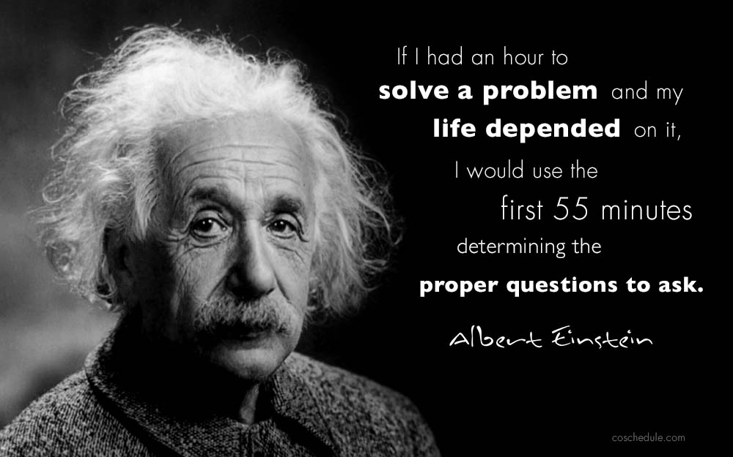
To become a good writer, you need to be a good reader
As you read a paper or chapter of a book, think about the questions that each sentence is answering.
As you write your own text, think about your reasons for writing each sentence. Ask yourself questions!
If it helps, try talking to yourself as you write!

Slide 19
Task 3
Here is the introduction to a dissertation.
The 4 paragraphs have been mixed up. Bearing in mind what you know about steps and about anticipating reader questions, put them in the right order and then compare your answer to a neighbour’s.

Slide 20
B The thermal properties of glassy materials at low temperatures are still not completely understood. The thermal conductivity has a plateau which is usually in the range 5 to 10K and below this it has a temperature dependence which varies approximately as T2. The specific heat below 4K is much larger than would be expected from the Debye theory and it often has an additional term which is proportional to T.
Establishing the field
Summarising Previous Research
D Some progress has been made towards understanding the thermal behaviour by assuming that there is a cut-off in the phonon spectrum at high frequencies (Zaitlin and Anderson 1975a,b) and that there is an additional system of low-lying two-level states (Anderson 1975, Anderson et al. 1972. Phillips 1972).
Preparing for Present Research
A Nevertheless more experimental data are required and in particular it would seem desirable to make experiments on glassy samples whose properties can be varied slightly from one sample to the other.
C The present investigation reports attempts to do this by using various samples of the same epoxy resin which have been subject to different curing cycles. Measurement of the specific heat (or the diffusity) and the thermal conductivity have been taken in the temperature range 0.1 to 80K for a set of specimens which covered up to nine different curing cycles.
Introducing Present Research

Slide 21


Slide 22
Task 4
Look at the following statements. Discuss with a neighbour what is wrong with them. Decide together how you would improve them.
You can see the results in Table 1.
There are desirable benefits to be gained from increasing research into these materials.
The implementation of computer-integrated-planning has brought about some serious problems.
The results of a lot of different projects have been pretty good.
Continuous process technology was adopted. This was because of its greater efficiency.
The problem doesn't have many viable solutions.

Slide 23
How can you learn the appropriate style?
(i) Read other articles and theses in your discipline (search by subject on http://etheses.bham.ac.uk/)
(ii) Notice useful common academic expressions (e.g. The aim of the project was to develop...)
(iii) If you worry about the level of formality of your writing, book a one-to-one consultation with a BIA lecturer by emailing Ms Angela Stewart: a.stewart@bham.ac.uk
(iv) Look at the bank of academic language provided by the Academic Phrasebank: http://www.phrasebank.manchester.ac.uk/

Slide 24
Task 5
On the left side of the table below are some examples of ‘informal technical’ language collected from lectures at Birmingham University in the Departments of Plant Biology, Minerals Engineering, and Civil Engineering.
This language is appropriate when speaking, but how would you express the same ideas more formally in your academic writing?
Complete the more formal version of what the lecturer said by filling in the missing word from the box. You can make the task more challenging by not looking at the box.

Slide 25
Missing words: collide, deal, eliminate, executes, extracted, identify, inserted, occurs, recovered, reduces, supports, tolerate
Informal | Formal
In practice we can’t cope with all of the species. | In practice it is impossible to ___________ with all of the species.
The word ‘diversity’ crops up frequently in the literature. | The word ‘diversity’ ___________ frequently in the literature.
We feed in different values for Z into the equation. | Different values for Z are ___________ into the equation.
There is evidence that firms up Lab Report 1132. | There is evidence that ___________ Lab Report 1132.
Very fine solids are picked up in the cyclone. | Very fine solids are ___________ in the cyclone.
The particles bump into each other. | The particles _________ with each other.
When we recompact a soil we cannot get rid of the last 5% of air. | When we recompact a soil we cannot ____________ the last 5% of air.
In the type B roaster, part of the gas stream is pulled out through the second cyclone. | In the type B roaster, part of the gas stream is ___________ through the second cyclone.
The use of a large freeboard area cuts down the amount of recycling needed. | The use of a large freeboard area _____________ the amount of recycling needed.
In certain cases DNA can put up with one incorrect base pair. | In certain cases DNA can ___________ one incorrect base pair.
It is difficult to pin down the factors involved. | It is difficult to ___________ the factors involved.
The computer chews its way through the program. | The computer ___________ the program.
deal
occurs
inserted
supports
recovered
collide
eliminate
extracted
reduces
tolerate
identify
executes

Slide 26

Tomorrow’s session: Literature Review

